Slide 1
Group 3 Module 11.2 Presentation
Colin Hawkins
Morgan Bowen
Alondra Jimenez Contreras
Mark Thanandabouth

Slide 2
Group Introductions:
Colin Hawkins:
I'm Colin, from Ohio. I have my Associate's Degree in Software Development, and 2 years of experience as a developer. In the fall, I volunteer as a drumline instructor for my local marching band. In addition, I enjoy gaming and learning new skills all year round.
Morgan Bowen:
I’m Morgan. I have a Bachelor’s Degree in English and Psychology. Last year I discovered an interest in Software Development and decided to pursue it. I enjoy running, reading, and spending lots of time in and around water.
Mark Thanadabouth:
Hi, I'm Mark, blending experiences as a veteran, retail manager, and aspiring software developer. My downtime is filled with exploring new knowledge on YouTube, CrossFit workouts, and gaming adventures in Apex Legends.
Alondra Jimenez Contreras:
I’m Alondra from Ohio, I'm a quality call analyst, I enjoy learning how things work, and problem solving, youtube has been a great resource I enjoy spending time with my family in my downtime.

Slide 3
Willson Financial Case Study Description
Jake and Ned Willson decided to open a financial advising and management company in their small town in New Mexico. They had an interest in serving the community of farmers and ranchers and those who are considering retiring soon. After obtaining their CFAs and registering the company with the SEC, they hired Phoenix Two Star and June Santos. With the success of their business at the end of the year, Jake and Ned were wondering if they should change their billing structure. They took a look at their client list, assets, amount of transactions and their current billing structure in order to evaluate this possibility.

Slide 4
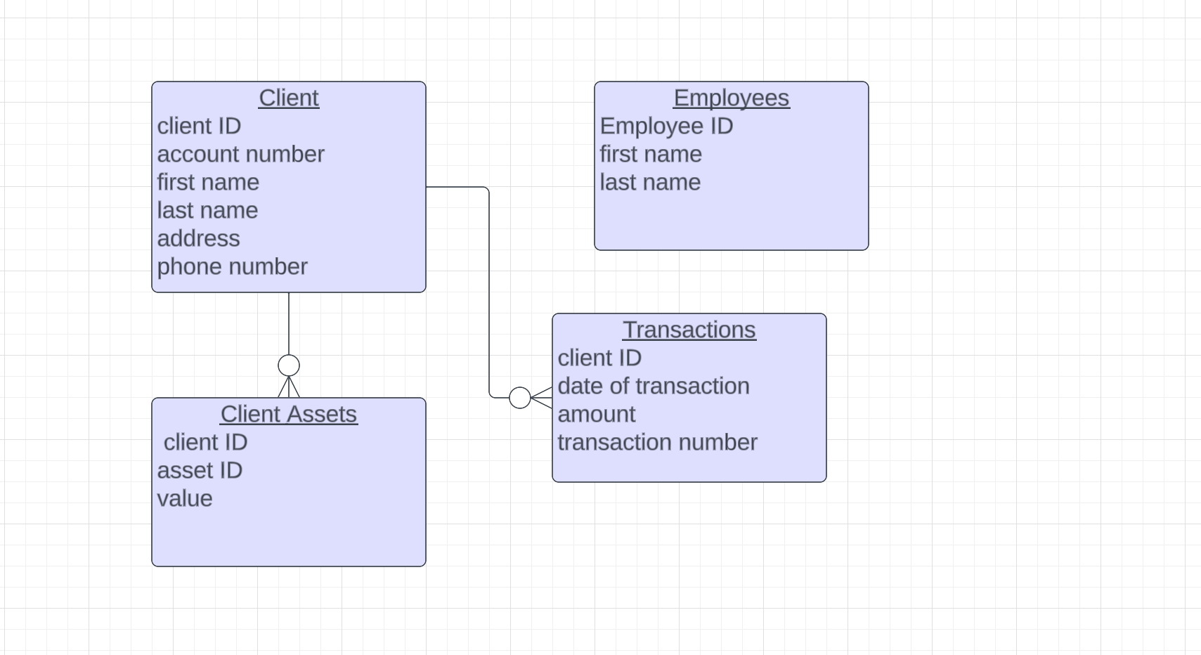
ERD

Slide 5
Report Descriptions
The system can generate a New Clients Report, Asset Overview for a Specific Client Report and a Transaction Report for a Specific Client.
New Clients Report :
- Objective: To provide a breakdown of new clients added in the current year.
- Data: Client details, number of assets, and total asset value.
- Functionality: The report lists each new client with their ID, name, date added, number of assets, and total asset value.
Asset Overview :
Objective: To provide a detailed overview of a specific client's assets.
Data: Asset type, ID, and value.
Functionality: The report lists all assets for a given client, including the total and average value of these assets.
Transaction Report
- Objective: To detail the transactions of a specific client.
Data: Transaction date, number, and amount.
Functionality: The report lists all transactions for a given client, including the total value and count of transactions.

Slide 6
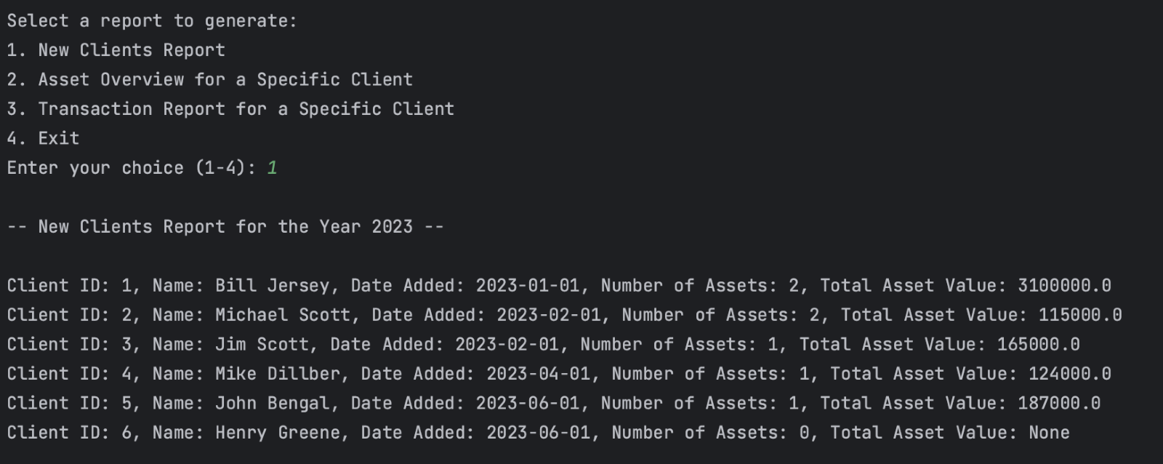
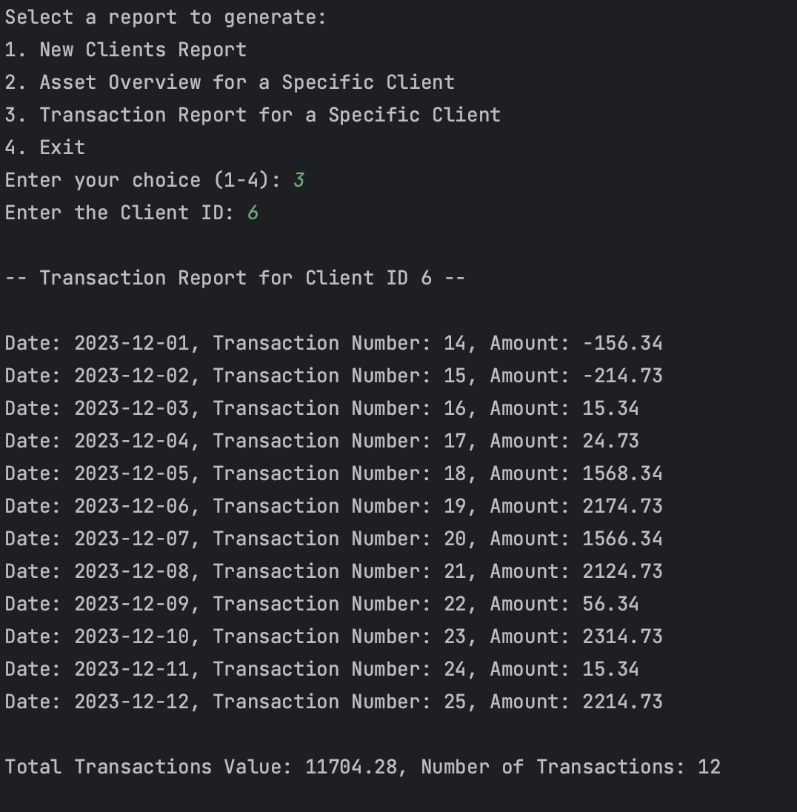
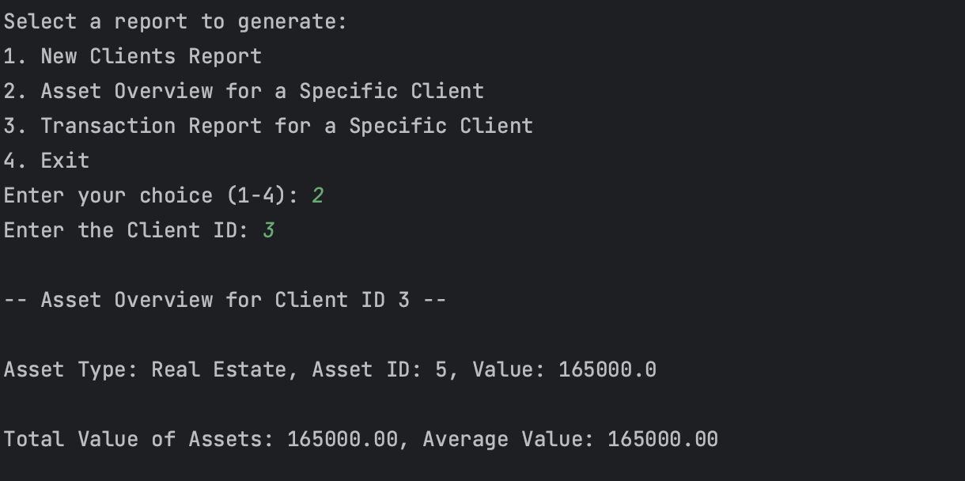
Report Results
New Clients Report:
Transaction Report:
Asset Overview Report:

Slide 7
Case Study Assumptions
The Company only has one location.

